Slide 1

Comprehensive Outdoor Recreation Plan (CORP)
Project Check-In Meeting
May 15, 2023

Slide 2
Project Schedule
PRC Kick-Off Meeting:
  Review draft survey questions, park facilities inventory, preliminary needs assessment,
  park assessment form and discuss big picture park system questions.
PRC Meeting 2: May 15, 2023 ← Tonight
  Review survey results, maps, preliminary recommendations
PRC Meeting 3: July 17, 2023
  MSA presents full draft plan
  PRC votes to recommend adoption by Village Board
Public Meeting #2: November 23, 2023
  Present draft Comp Plan and CORP
Village Board Adoption: January 23, 2023
  Comp Plan & CORP

Slide 3
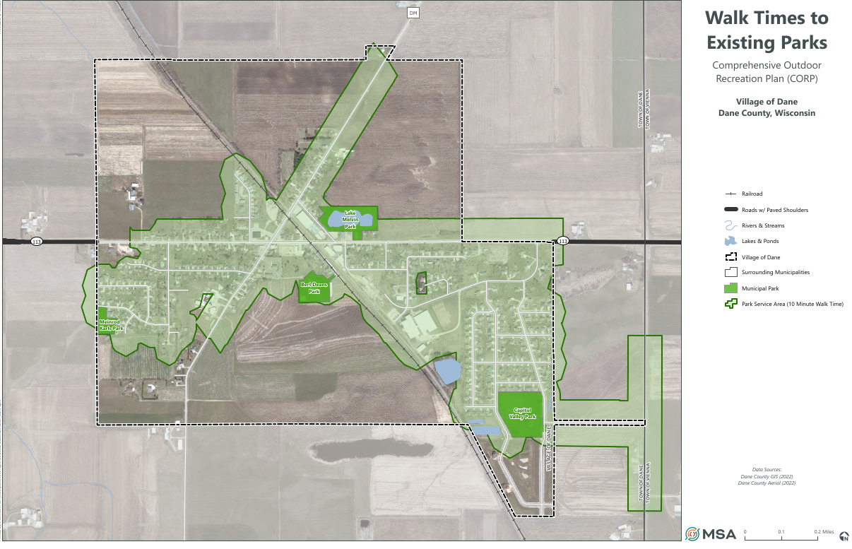

Slide 4
Survey Results – Outdoor Recreation Questions
164 responses – 14.7% of Village!

Slide 5
Survey Results

Slide 6
Survey Results

Slide 7
Survey Results
Where in the Village would you prioritize the location of new bike facilities, routes, or trails?
Connection to Lodi, Waunakee, and Springfield
Along Main St/113
  Others stated the opposite; concerns for safety
Capital Valley area
Snyder Estates
Connections between all the parks
Along train tracks
Military Road

Slide 8
Survey Results

Slide 9
Survey Results

Slide 10
Survey Results

Slide 11
Survey Results
“No close parking for Bert Dean's Park for elderly or handicapped.”
“Lighting within the parks at night.”
“We have a huge neighborhood with many kids and an extremely small playground that has broken equipment. It has never been updated since we have lived here which has been over 12 years.”
“In the Capital Valley park there is really no accessibility for wheelchairs or a handicap swing, etc. One would imagine with the baseball diamond there would be better accessibility for grandparents, parents, or siblings that are disabled.”
“Capitol Valley needs level sidewalks to playground area and then to shelter and restrooms.”

Slide 12
Survey Results

Slide 13
Survey Results

Slide 14
Survey Results
Other comments relating to pedestrian, bicycle, park and recreation services or facilities in the Village of Dane:
“All the parks in Dane have similar playground equipment, would be nice to have more of a variety."
As the village grows we need to have facilities that keep new residents playing and exercising locally. It helps create interest in keeping out community strong and safe.”
“Our parks need attention on updates and repairs. All bike path and walk paths should avoid village streets and roadways used by cars trucks and agriculture machinery”
“Upgrading parks should be a top priority”
“It is hard to walk down main st, especially around the railroad tracks because the sidewalk is not continuous and it is not safe to walk on the road. Also the sidewalk at the corner of main where the hardware store is needs better drainage as it becomes a huge puddle when it rains or the snow melts and it gets really slippery when the water freezes.”
“parks are run down”
“Less time on the baseball fields that are used a few times a year and more time on the park grounds and playgrounds used daily.”

Slide 15
Park Assessment Forms – Capitol Valley Park
Wants
A multi-use court
Adult workout equipment
A large party shelter with a full kitchen
Winter activities-maybe a skate ring if not too much maintenance
A path connecting to other parks
Soccer or volleyball nets/space
Play structures for older kids
Grills
Tennis court
Monkey Bars
Large 4 season shelter accommodating indoor activities.
Multi-use Community Building with kitchen, bathrooms, event space.
Paved play area
Needs
Lighting (x3)
Path connecting to other parks
Multi-use courts
Person/dog water filling station
Shelter equipped to support pleasant weather gatherings. Multi use court.
Multi-use court (volleyball, pickle ball, etc.)
Soccer requirements or space?
Disk Golf
Shade and Ornamental Trees
Grilling option
Picnic Tables
Accessible Playground Equipment – include sensory options

Slide 16
Park Assessment Forms - Bert Deans Park
Wants
More trees or shade tents
Updated shelter- larger barn themed would be neat
Updated play equipment for older kids too
Updated lighting
Tribute wall
Parking
Trail connecting parks
Updated basketball courts
Zipline
More trees
Talking tubes + teeter toter
New playground area
Consider replacing existing structures with one building to serve as a shelter/kitchen/serving area/bathroom. This would allow more space for additional playground equipment or shade trees. This could be on a 10 year plus vision with budgeting and fundraising
Fix the lighting of the ball diamond
Needs
Trail connecting parks
Updated lighting
Parking
Updated play equipment
Shade trees or structures
Person/dog water station
More/new swings
Bee control
Existing shelter maintenance.
Fix the concrete in the shelter
Energy efficient lighting (five year plan).
Trees; Bike Rack
Signage to indicate there is a basketball court (court is well hidden unless you went looking for it)
Asphalt may require a better base/thickness to accommodate activities or occasional traffic related to events (5 year plan).
Large shelter requires attention.
Basketball court—can this be multi-use without impacting nearby crops?

Slide 17
Park Assessment Forms – Lake Melvin Park
Wants
Lighting?
Naturalized vegetation
Tribute wall
Gazebo structure -something more pretty than a shelter
If we are making this a dog walking park then we need safer fencing. Current fence to farmers field is old rusty barb wire. Noting we would not to have dogs swimming in pond.
Ice skating retention pond
Dog park
Sculpture
Better lighting for dusk time strolls
Needs
Trail connecting parks
Trees or naturalized vegetation
Restroom/ Portable toilets
Shade and Ornamental Trees
Either Prairie plantings or Pollinator Garden
Walking path around the water (paved, crushed stone or mowed)
Designated dog park area
Water station
Improved entrance off directly off Main (including landscape near the Historical Sign)
Pergola or Trellis Options?
Bike Rack
More picnic tables
Remove or repair old bench (park has adequate amount of benches)
A plan that will allow us the ability to apply for grants, fundraising and cap. Budgeting
Have the ground rolled to allow safer walking

Slide 18
Park Assessment Forms – Meinrod Karls Park
Wants
Parking
Fire pit/circle area
Bathrooms with flush toilets
There is a large open space, maybe a good use to play kickball, corn hole…
Shelter with electric, running water maybe half kitchen
Grills
Trail connecting parks
More swings
Shelter equipped to support gatherings.
Needs
Trail connecting parks
Toilets
Person/dog water station
Bathroom (x2)
Parking
Strategically placed shade trees or native species.
Bike rack
Council Ring – (see example at Indian Lake Park.
6 Adirondack Chairs placed to enjoy the view or a few additional benches.
Potential for other recreational activities on a parcel this size.

Slide 19
Discussion – Priority Improvements for Existing Parks
What are the top improvements for each park?
Can we rank them in terms of priority?
  Low priority – complete in 6+ years
  Medium priority – complete in 3-5 years
  High priority – complete in 1-2 years

